Slide 1
introducing POWERPOINT 2017
a tour of new features
Notes:
This presentation demonstrates the new capabilities of PowerPoint and it is best viewed in Slide Show. These slides are designed to give you great ideas for the presentations you’ll create in PowerPoint 2011!
For more sample templates, click the File menu, and then click New From Template. Under Templates, click Presentations.

Slide 2
Enhancing Your Presentation
1
2
3
Author Your
Presentation
Enrich Your
Presentation
Share Your
Presentation
We have features for every step of the way

Slide 3
Test 1 Amazing look
1
Design and organize

Slide 4



Getting Started with Templates
You don’t have to start from scratch.
If you need help with a status report or ideas for a photo album, look no further.
Use sample templates to kick-off your presentation and focus on the content (you’re viewing one right now!)

Slide 5

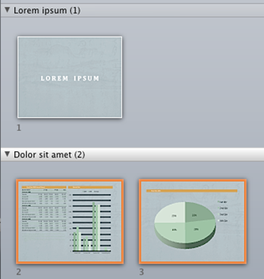
Too much information?
Divide and conquer a large presentation by organizing your presentation with sections.
Organize with Sections
You can name, print, and apply effects to an entire section easily.

Slide 6

Enrich Your Presentation
2
Stylize, edit, and animate your media

Slide 7


YOUR MESSAGE.
It’s not just about the visuals, but strengthening

Slide 8





New Picture Effects
Picture Color, Corrections, Artistic Filters,
and Background Removal allow you to customize images for your story

Slide 9


Movie Perfect
You can do a lot more with movies in PowerPoint 2011.
Movies can be embedded in your presentation. That’s right, no more lost movies!
Also, you can recolor the entire movie or apply a movie style easily. Your movies will look great!

Slide 10
What about the beautiful transitions you’ve been seeing?
Exciting new transitions
They are new too.

Slide 11
Share Your Presentation
3
View your slides from anywhere!

Slide 12





Collaboration
Simultaneous edits on one single document. No more waiting your turn or managing multiple versions.
It’s about team work, and co-authoring will get you there.

Slide 13

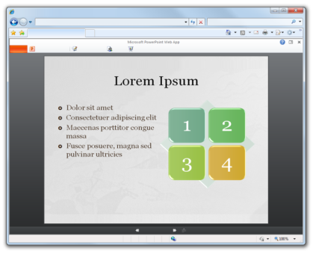

Access Anywhere
Check out the
PowerPoint Web App
Access slides wherever you are

Slide 14





POWERPOINT 2011
What’s Your Message?

